Slide 1

Sentiment Analysis of Amazon Electronics Reviews
Adam Stuhltrager
Ramana Bhaskar Kosuru
Chaya Chandana Doddaiggaluru Appajigowda

Slide 2
Problem Statement & Objectives
Problem: Understand customer sentiment in electronics product reviews
Importance: Helps manufacturers and retailers gauge product reception
Automation: Enables large-scale review analysis efficiently
Goal: Develop and compare NLP models for sentiment classification accuracy

Slide 3

Dataset Overview
Source: Amazon Electronics Reviews dataset (McAuley Lab, UCSD)
Features:
Star ratings (1-5)
Review text
Review titles
Helpful votes
Verified purchase indicators

Slide 4





Data Collection and Preprocessing
Data Collection
Millions of Amazon Electronics reviews gathered
Text Cleaning
Removing non-alphabetic characters
Standardization
Lowercase conversion, stop word removal
Feature Extraction
TF-IDF and word2vec implementation

Slide 5






Understanding Sentiment Analysis
Positive
Expressions of satisfaction or approval
Neutral
Factual statements without emotion
Negative
Expressions of dissatisfaction or criticism

Slide 6
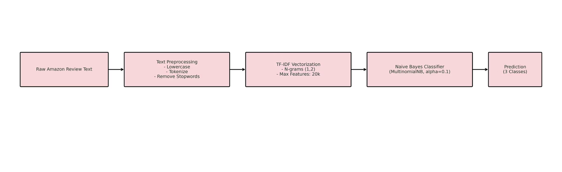
Naive Bayes Model Pipeline:

Slide 7
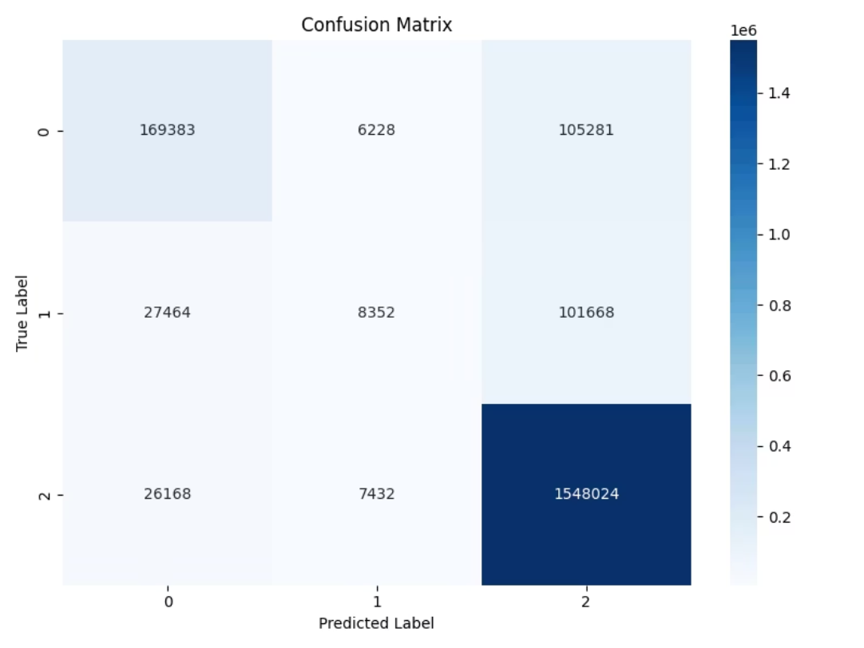
Naive Bayes Model:

Slide 8
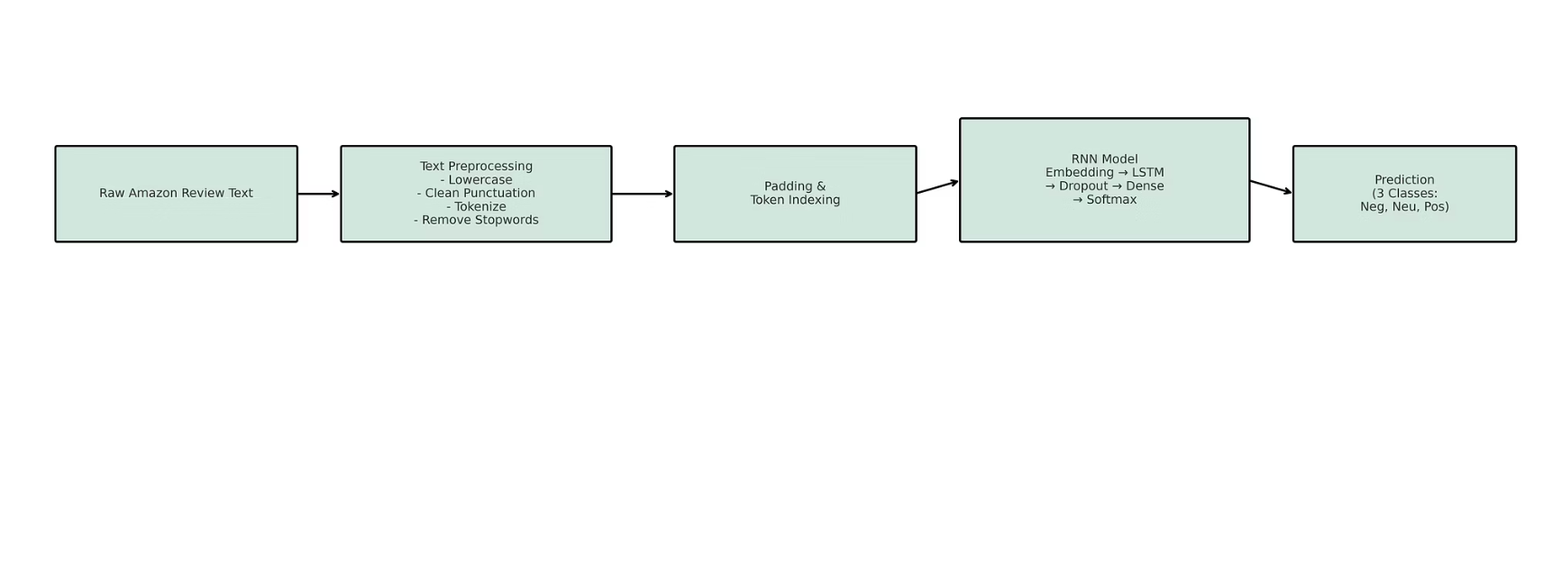
RNN Model Pipeline:

Slide 9
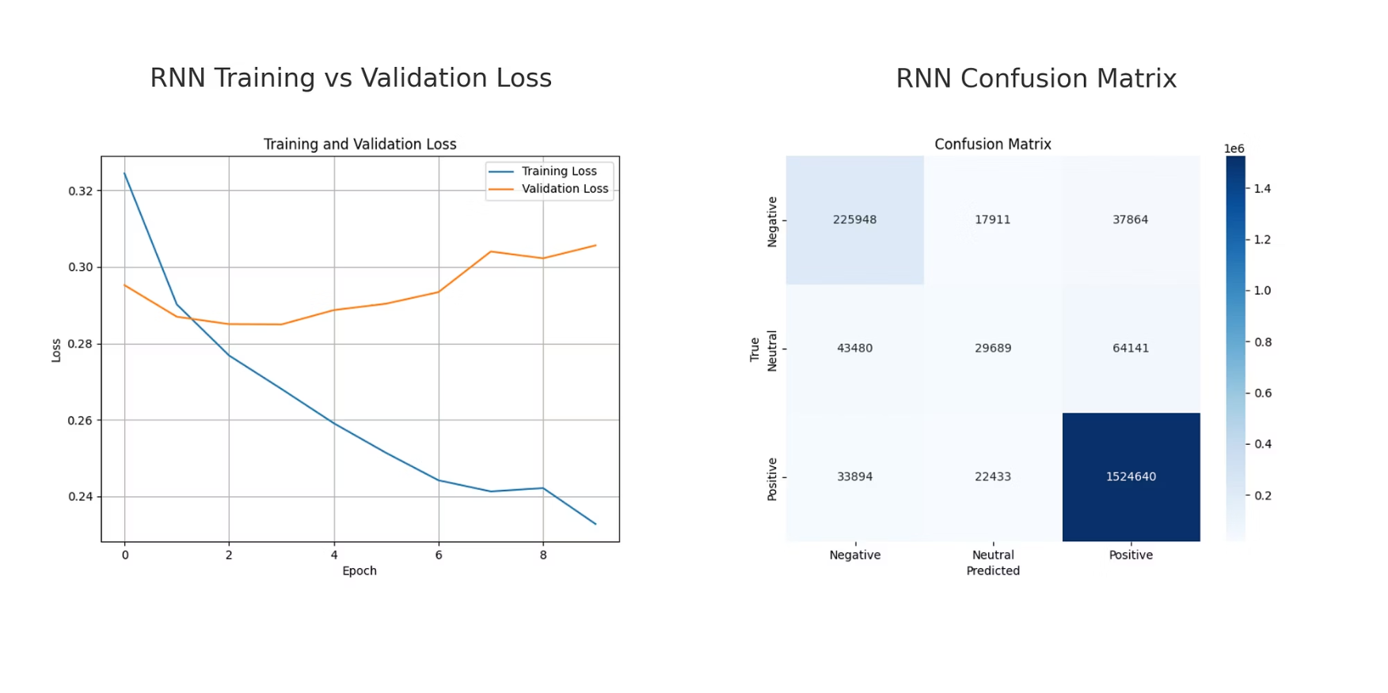
RNN Model:

Slide 10
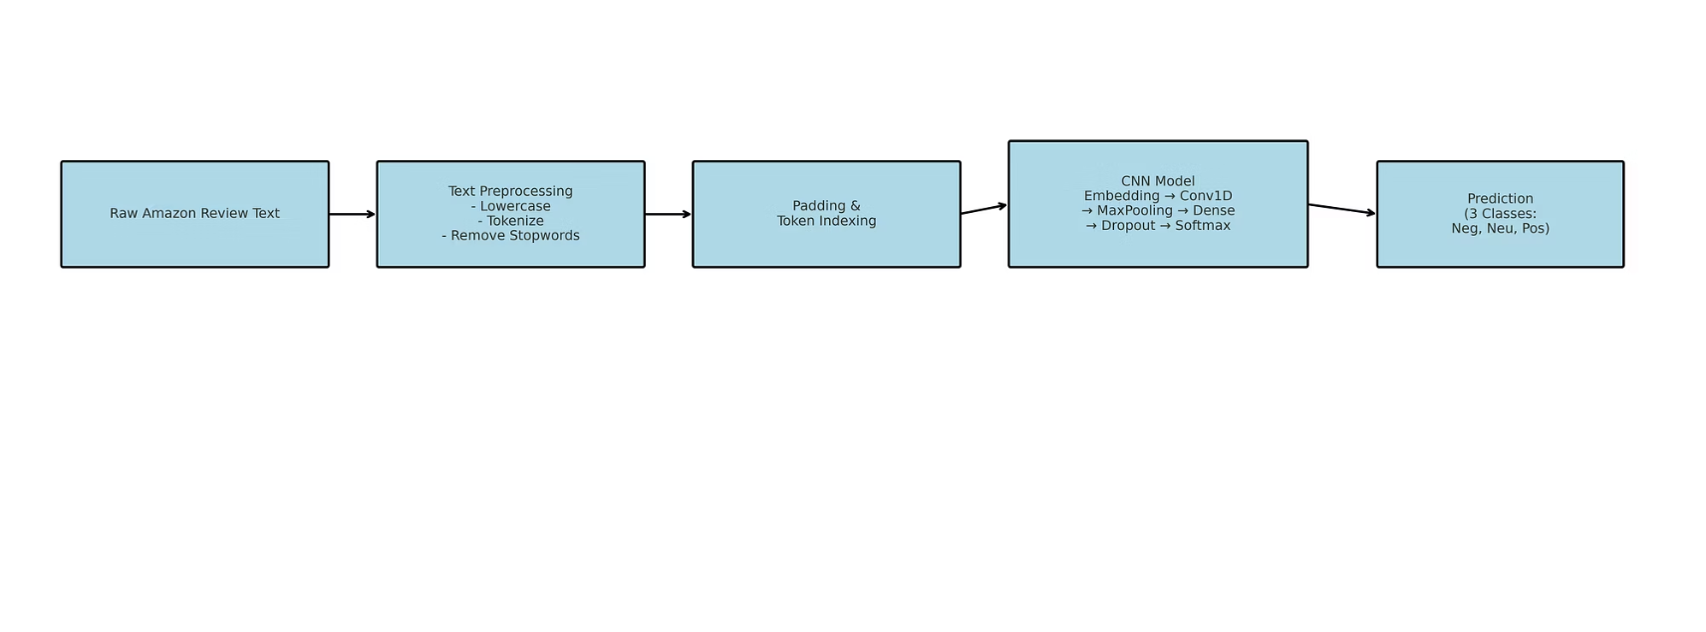
CNN Model Pipeline:

Slide 11
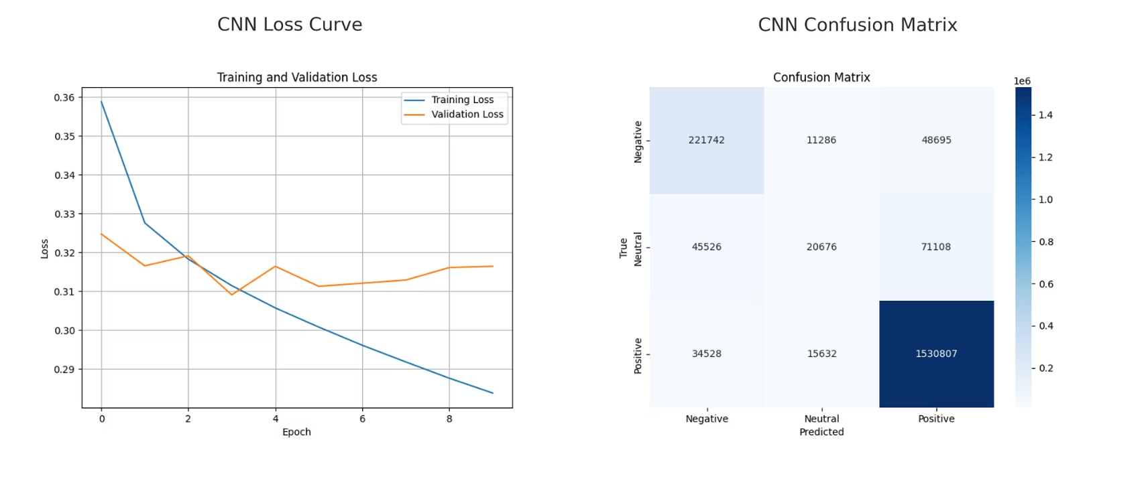
CNN Model:

Slide 12
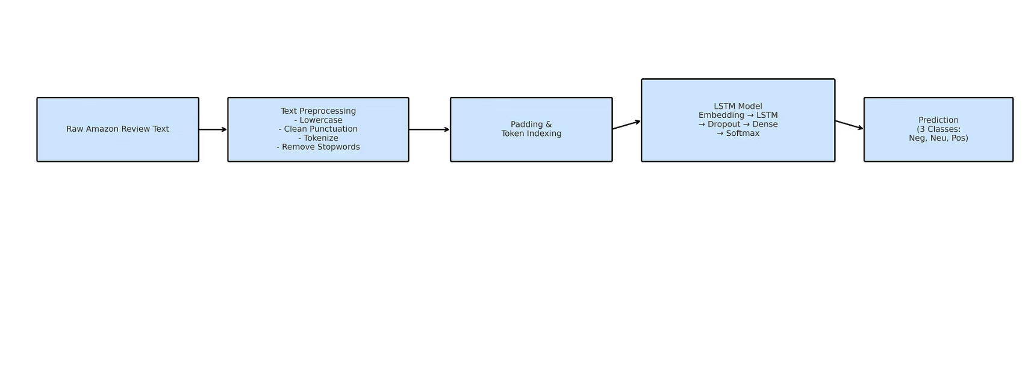
LSTM Model Pipeline:

Slide 13
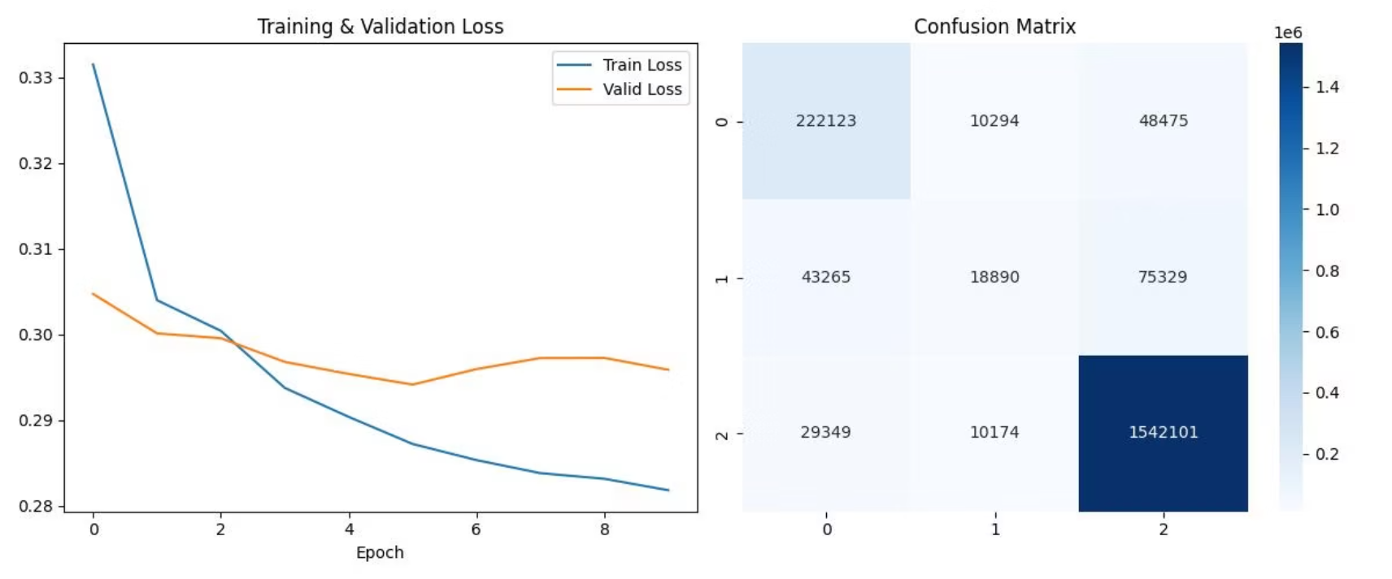
LSTM Model:

Slide 14
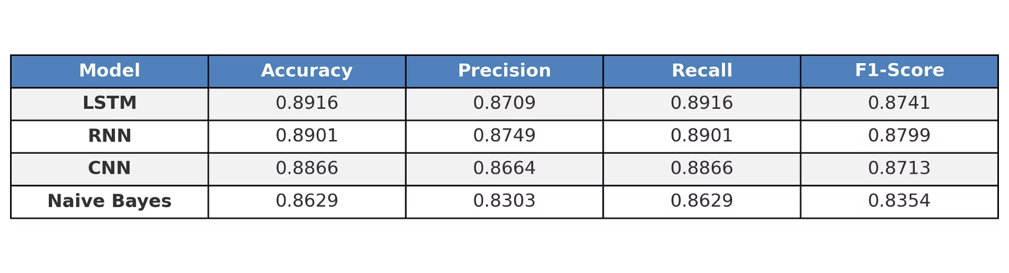
Model Comparison Table:

Slide 15
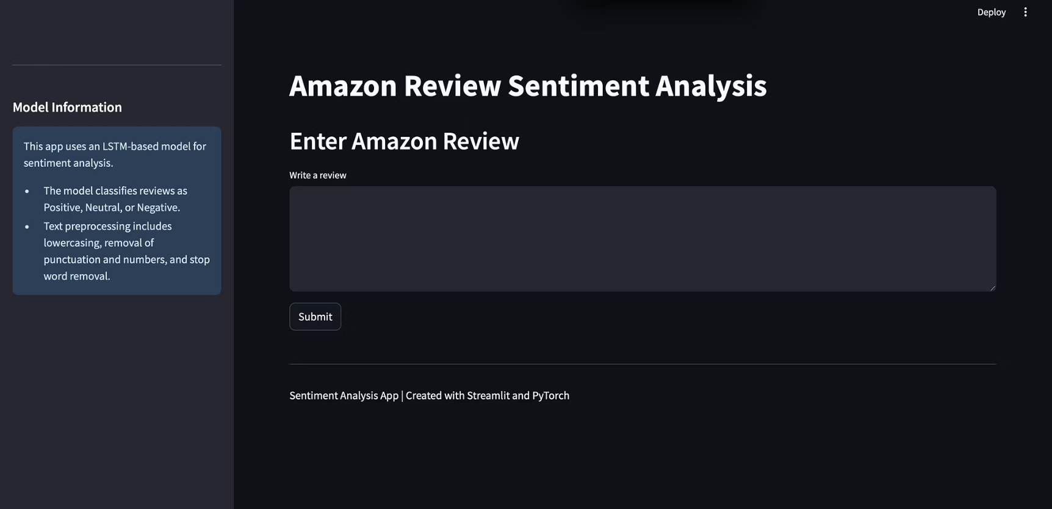
Streamlit App:

Slide 16




Future Directions
Multi-Modal Fusion
Combine CNN-LSTM or transformer-vision pipelines to integrate text and visuals from product images and videos, enhancing sentiment analysis with richer user emotion insights.
Automated Customer Replies
Use GPT-4 to generate tailored responses based on sentiment predictions, speeding up customer service and easing agent workload.
Unified Model with Category Feature
Add a “category” embedding alongside text inputs during preprocessing to create a single sentiment analysis model that covers multiple product categories like Books, Apparel, and Home & Kitchen.

